Slide 1

冒險故事
Notes:
https://unsplash.com/photos/white-explore-flag-z55CR_d0ayg

Slide 2

1.目標
Notes:
https://unsplash.com/photos/a-close-up-of-a-dart-with-a-card-on-it-Ai0HaqLdhSA

Slide 3

Notes:
https://unsplash.com/photos/a-group-of-people-standing-around-a-table-with-a-laptop-qY8AWXa3Le4

Slide 4

2.阻礙
Notes:
https://unsplash.com/photos/a-close-up-of-a-wooden-surface-with-squares-and-rectangles-hy7L2ItQRwM

Slide 5
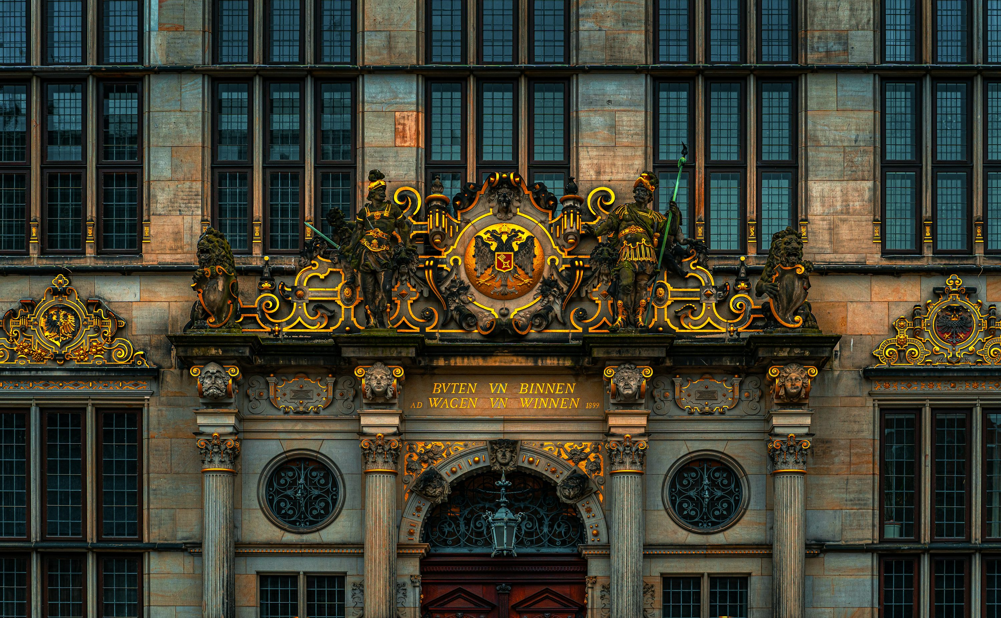
Notes:
https://unsplash.com/photos/a-large-building-with-a-clock-on-the-front-of-it-srHmISI6sU4

Slide 6

3.努力
Notes:
https://unsplash.com/photos/toddlers-standing-in-front-of-beige-concrete-stair-bJhT_8nbUA0

Slide 7
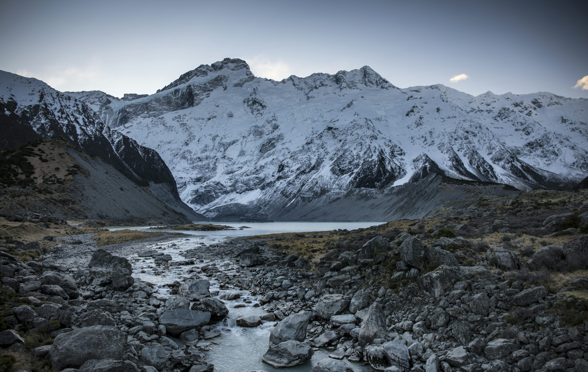
Notes:
https://unsplash.com/photos/creek-under-glacier-mountain-and-sky-LKQGNBZAWU8

Slide 8

4.結果
Notes:
https://unsplash.com/photos/a-close-up-of-a-street-sign-on-the-ground-dwAg22U6Ymg

Slide 9

Notes:
https://unsplash.com/photos/a-lit-up-box-sitting-on-top-of-a-table-mkxTOAxqTTo

Slide 10
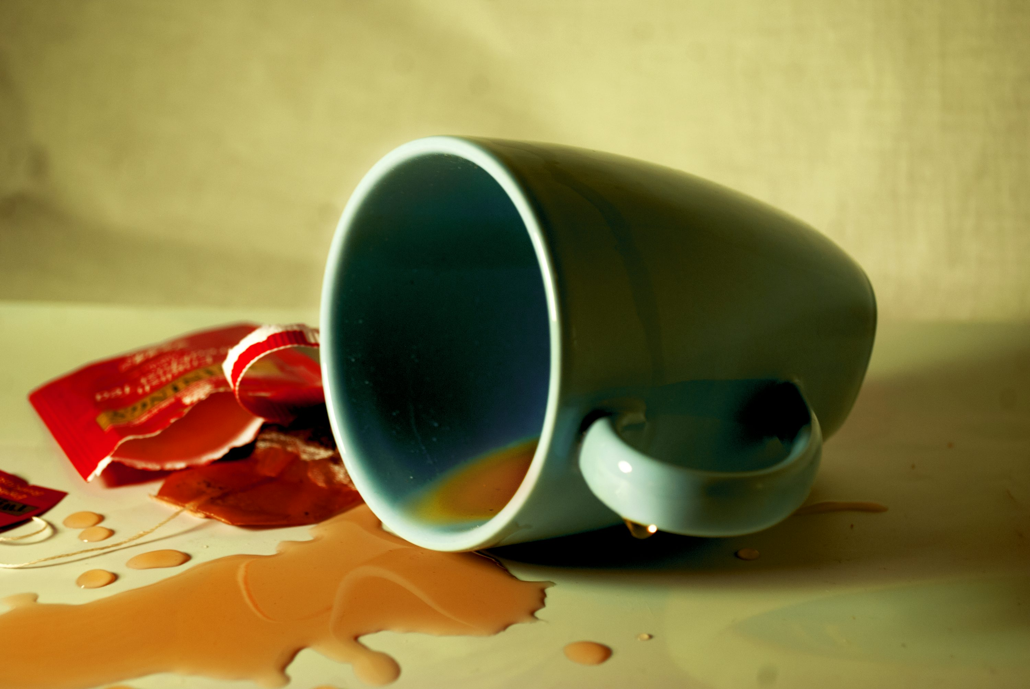
5.意外
Notes:
https://unsplash.com/photos/a-coffee-cup-spilled-on-a-table-oSOY6Ozl6T0

Slide 11
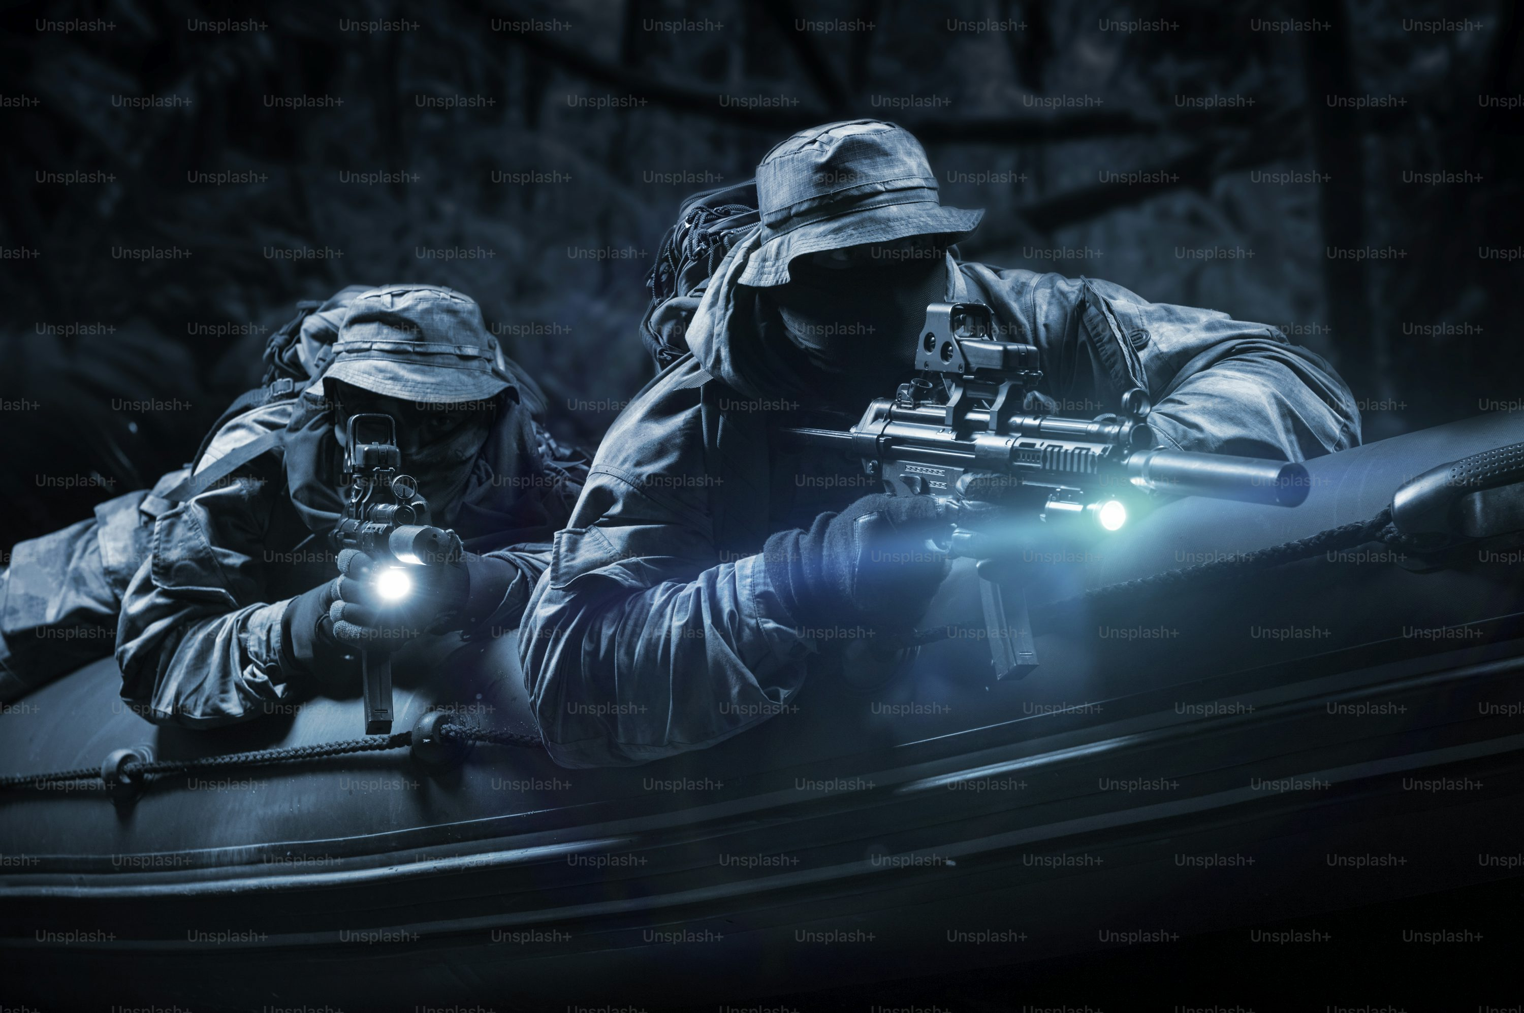
Notes:
https://unsplash.com/photos/two-fighters-of-a-special-unit-move-through-the-forest-at-night-the-concept-of-special-operations-nato-war-mixed-media-y81TIt-k2zc

Slide 12

6.轉折
Notes:
https://unsplash.com/photos/bokeh-light-photo-M-xaOaCzy_M

Slide 13

Notes:
https://unsplash.com/photos/bokeh-light-photo-M-xaOaCzy_M

Slide 14

7.結局
Notes:
https://unsplash.com/photos/selective-photography-of-body-of-water-under-white-sky-at-daytime-T_gAmymcQFs

Slide 15
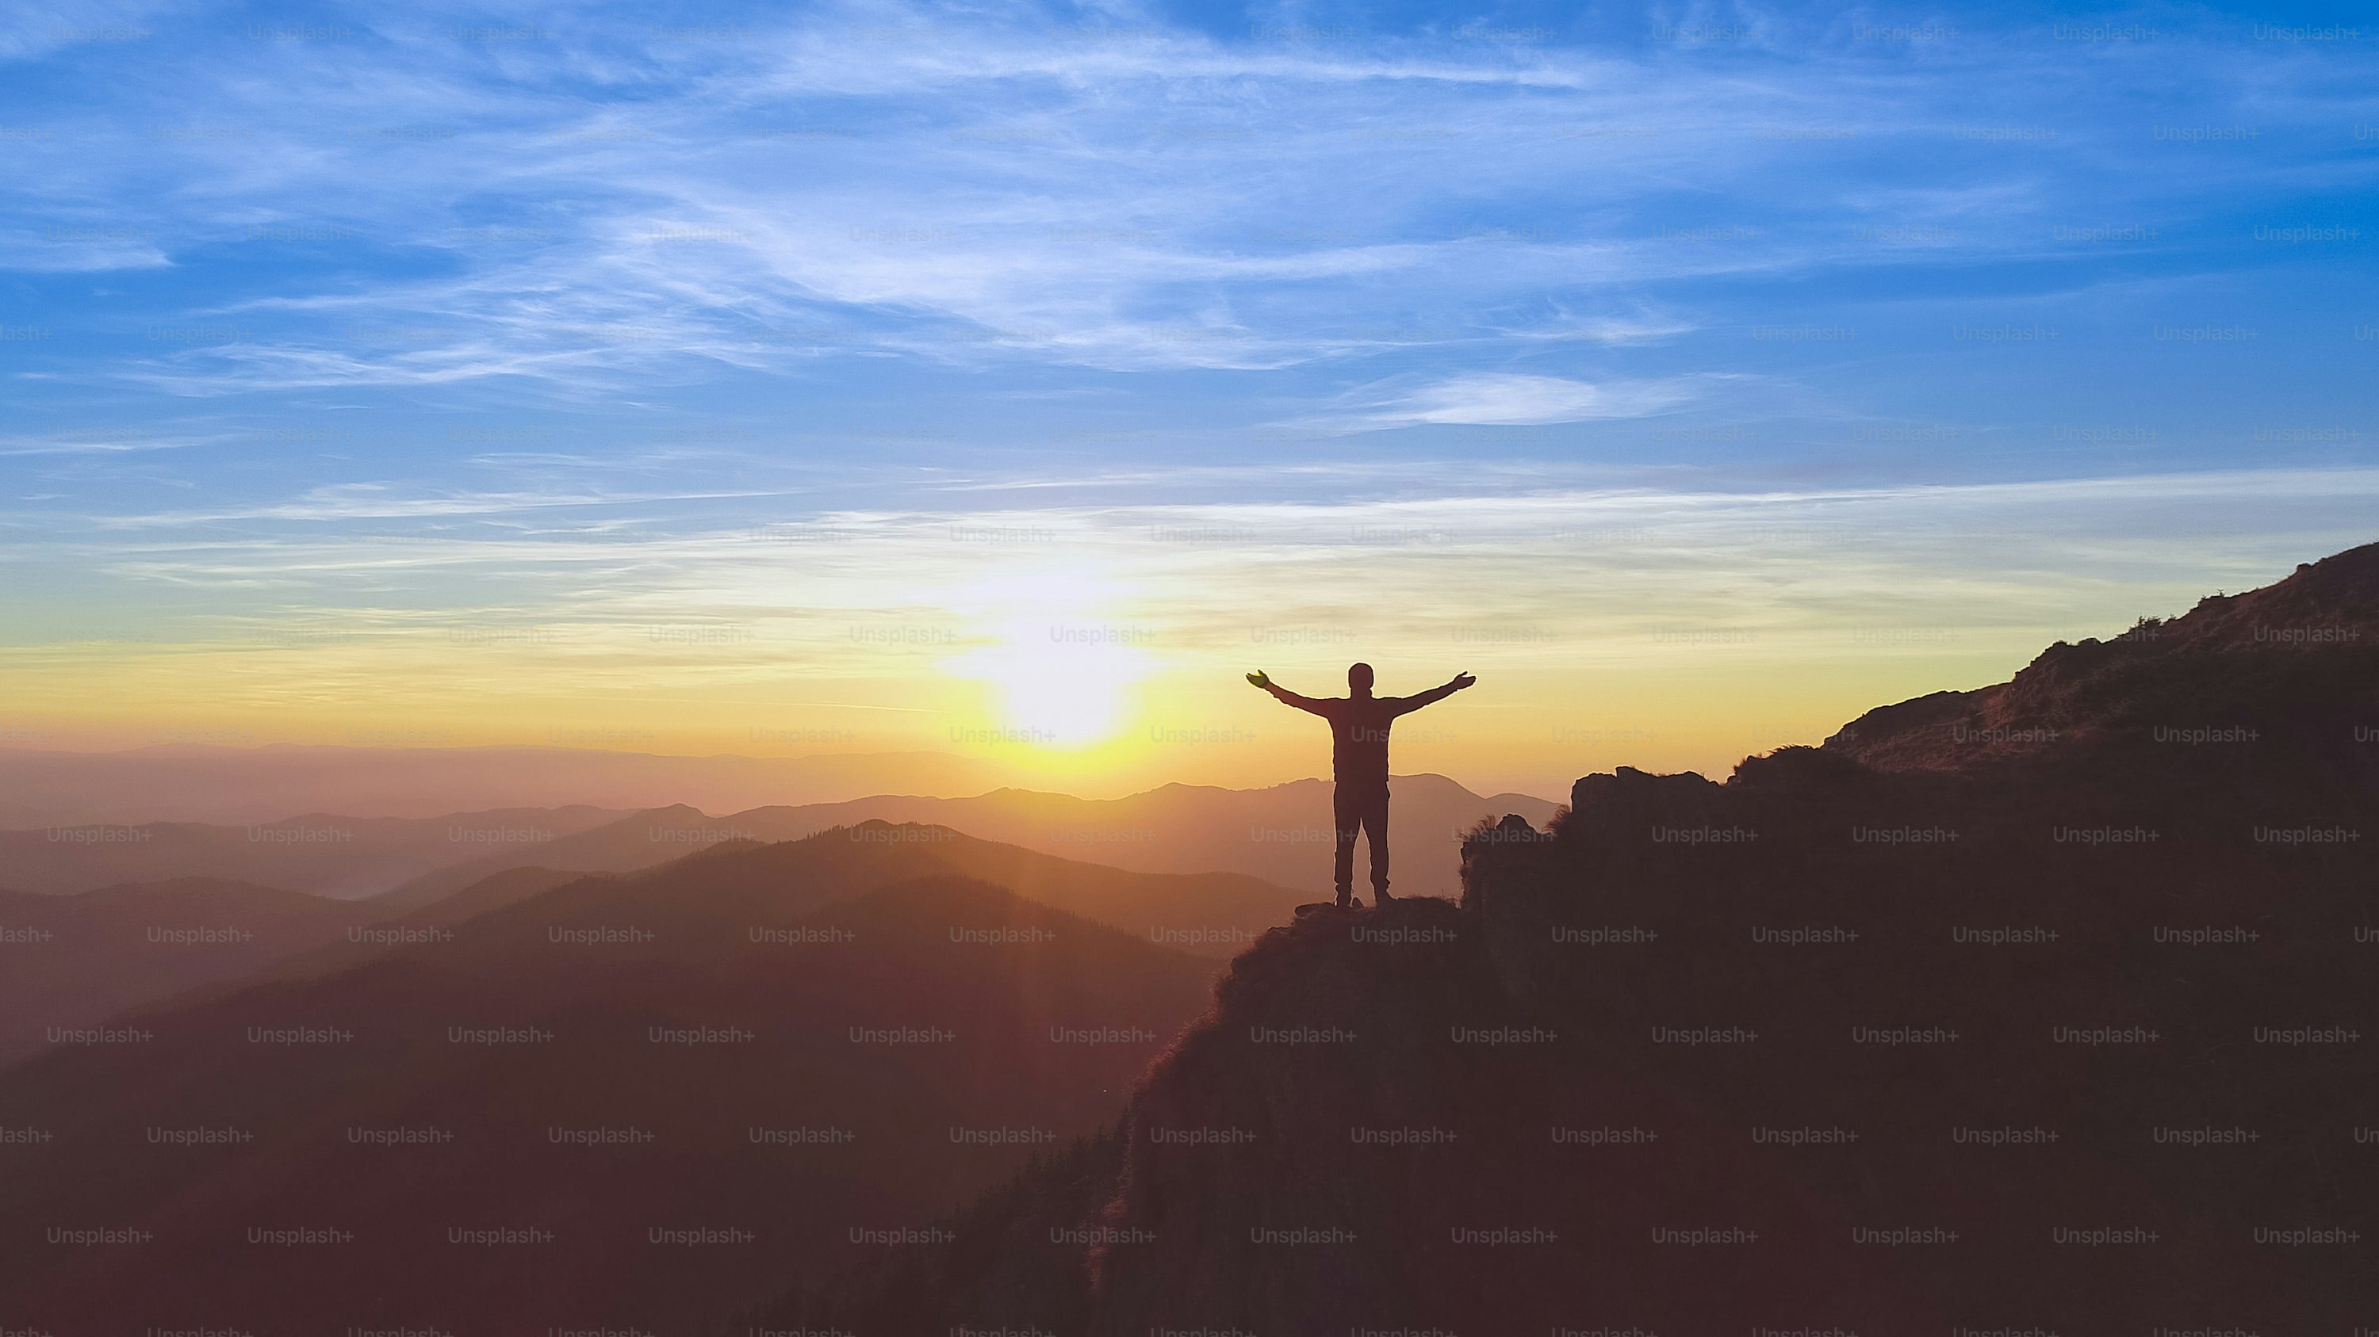
Notes:
https://unsplash.com/photos/the-man-standing-on-the-mountain-on-the-picturesque-sunset-background-bEOrxHU2Op8

